Slide 1
Progress report
Speaker: Geng-Yun Tien
Advisor: Eric Y. Chuang
Date: 2023/11/29

Slide 2
Works
1
Implement AttMIL (attention-based multiple instance learning) to KRAS mutation prediction
2
Implement TransMIL (transformer-based correlated multiple instance learning) to KRAS mutation prediction
3
Implement GnnMIL (multiple instance learning with graph neural network) to KRAS mutation prediction

Slide 3
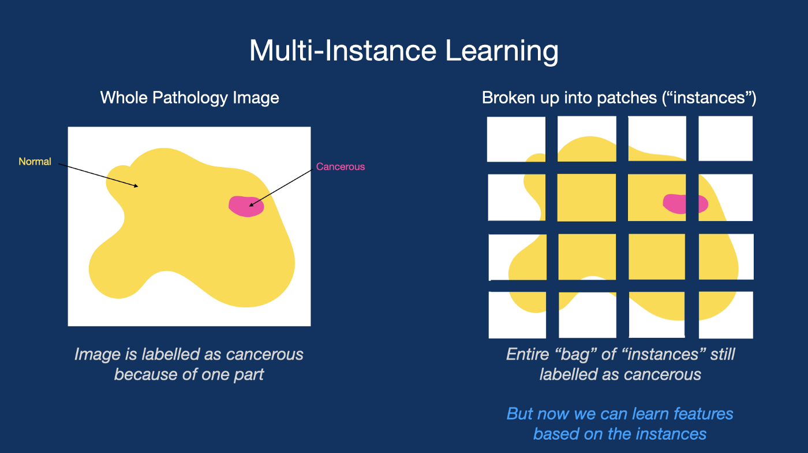
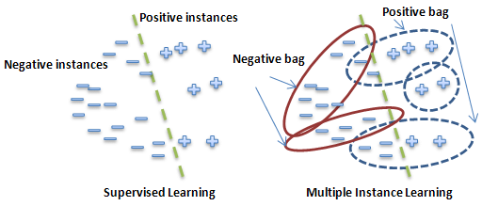
Multiple instance learning
Multiple-instance learning (MIL) is a type of supervised learning, also called weakly supervised learning.
Instead of receiving a set of instances which are individually labeled, the learner receives a set of labeled bags, each containing many instances.
We can use only the slide-level diagnosis as our label without any patch-level annotation.

Slide 4

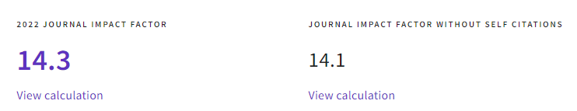
Literature review

Slide 5
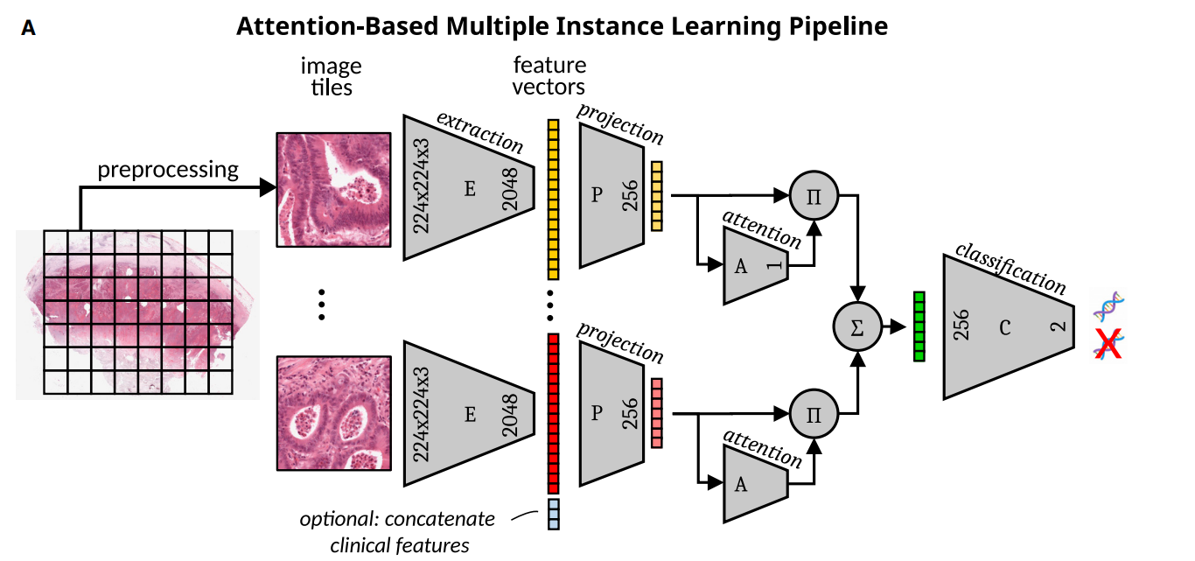
Proposed pipeline

Slide 6
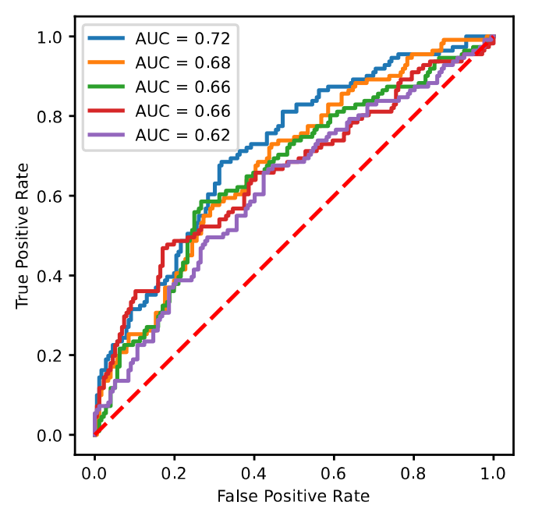
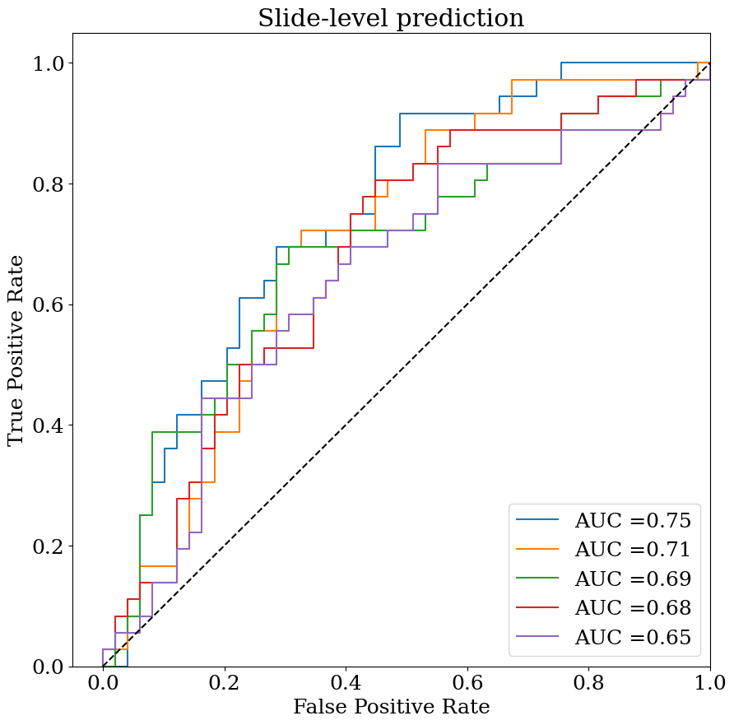
Results comparison in testing set
Literature result: AUC 0.67 ± 0.04
Our result: AUC 0.7 ± 0.04

Slide 7
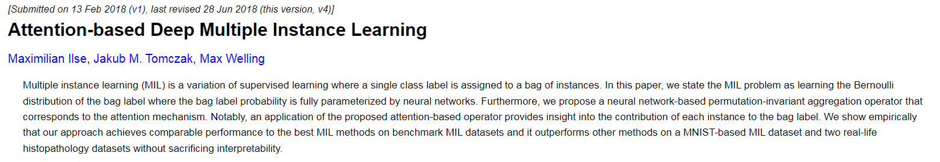
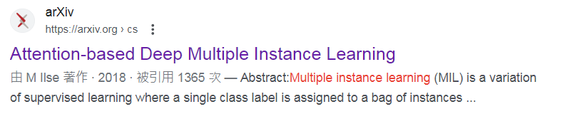
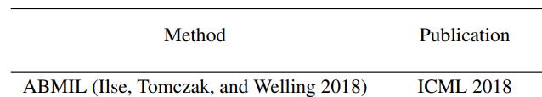
AttMIL (attention-based multiple instance learning)
ICML: International Conference on Machine Learning

Slide 8
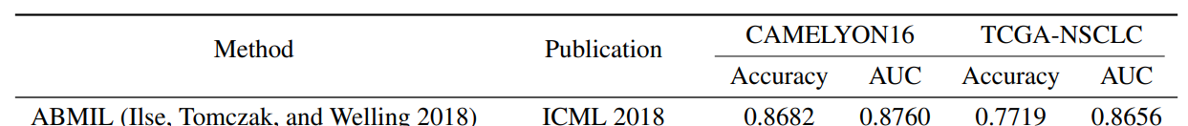
AttMIL results

Slide 9
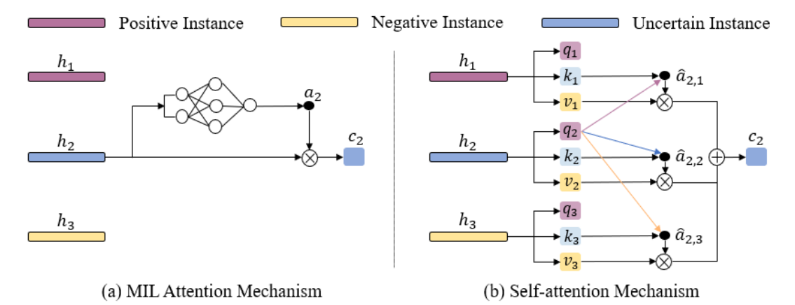
MIL Attention Mechanism VS. Self-attention Mechanism
MIL Attention Mechanism: attention-based multiple instance learning
Self-attention Mechanism: transformer-based correlated multiple instance learning

Slide 10
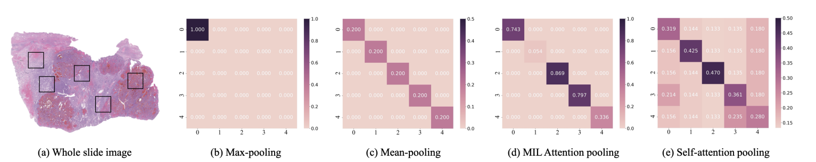
Difference between different pooling matrix P
Suppose there are 5 instances sampled from WSI
The values in the diagonal line indicate the attention weight for itself and the rest indicate correlation between different instances

Slide 11
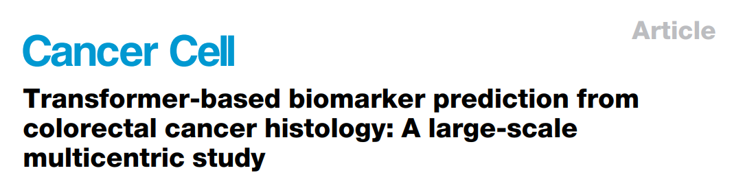
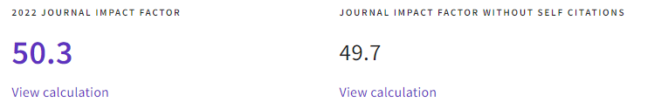
Literature review

Slide 12
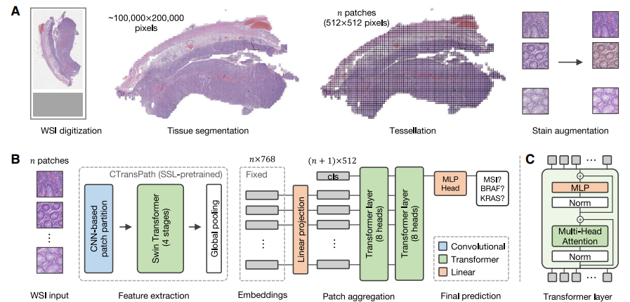
Proposed pipeline

Slide 13
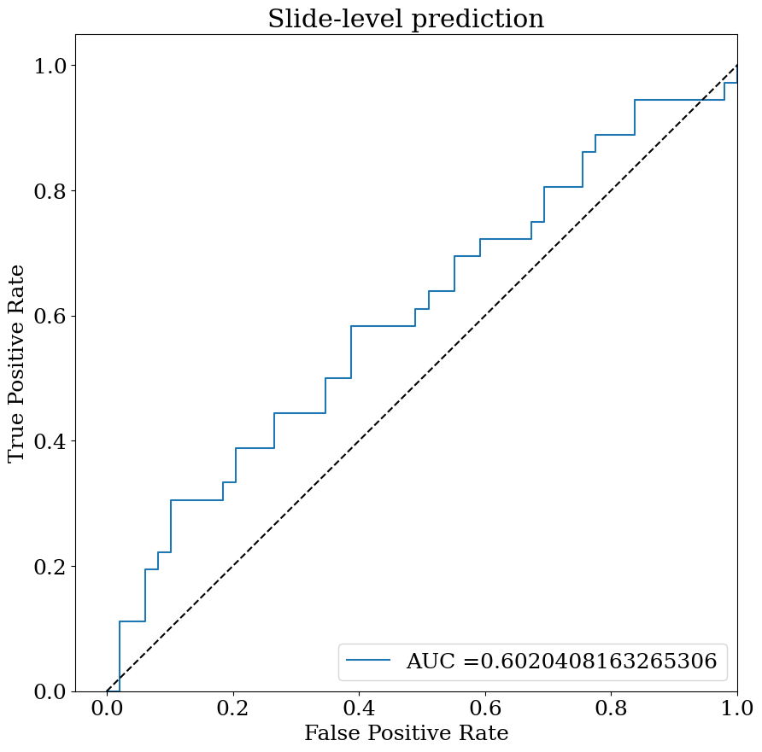
Results comparison in testing set
Literature result: AUC 0.61
Our result: AUC 0.6

Slide 14
Future work
1
Multiple instance learning with graph neural networks
2
Graphormer

